Slide 1
Large Language Models for Generative AI
AIML* ZG536
Dr. Monali Mavani

Slide 2

Large Language Models for Generative AI
Disclaimer and Acknowledgement
The content for these slides has been obtained from books and various other source on the Internet
I here by acknowledge all the contributors for their material and inputs.
I have provided source information wherever necessary
I have added and modified the content to suit the requirements of the course

Slide 3
Handout

Slide 4

Evaluation
Component | Details | Weightage
Assignments | Plan will shared by second week | 35%
Mid-term Exam | Closed Book | 30%
End Semester Exam | Open Book | 35%

Slide 5
Agenda
Foundations of Large Language Models (LLMs)
  Introduction to LLMs and Generative AI
  Attention Mechanism & Transformer (Review)
  Building blocks of LLM
  LLM Architectures
  Tokenization
  LLM landscape

Slide 6
Introduction to LLMs and Generative AI

Slide 7
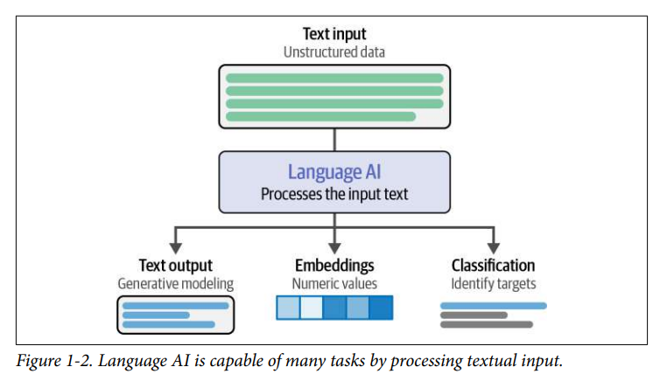
Language AI

Slide 8
Probabilistic Language Models
A model that computes either of these:
  Probability of a sentence ( P(W) ) or
  Probability of an upcoming word (P(w_{n}|w₁,w₂…w_{n-1})) is called a language model.
Simply we can say that
  A language model learns to predict the probability of a sequence of words.
A language model assigns a probability to each possible next word, or equivalently gives a probability distribution over possible next words
LM can tell us : P(all of a sudden I notice three guys standing on the sidewalk) >
P(on guys all I of notice sidewalk three a sudden standing the )

Slide 9
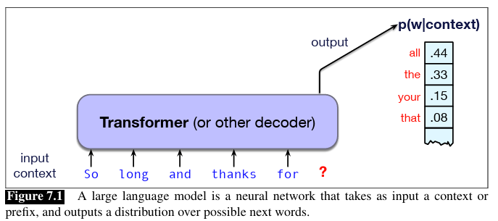
What is a Large Language Model?
LLMs are deep neural networks trained on massive amounts of text data, large portions of the entire publicly available text on the internet
The “large” in “large language model” refers to both the model’s size in terms of parameters, immense dataset on which it’s trained and larger context of words

Slide 10
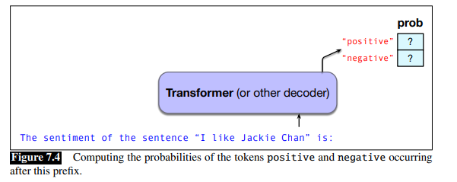
Conditional generation of text
Almost any NLP task can be modeled as word prediction in a large language model
E.g. Sentiment classification:
P(“positive”|“The sentiment of the sentence ‘I like Jackie Chan’ is:”)
P(“negative”|“The sentiment of the sentence ‘I like Jackie Chan’ is:”)
E.g. Question Answering
P(w|Q: Who wrote the book ‘‘The Origin of Species"? A:)
Notes:
Input to the LLM is a piece of text (a prompt )and then have the LLM continue generating text token by token, conditioned on the prompt and the subsequently generated tokens

Slide 11
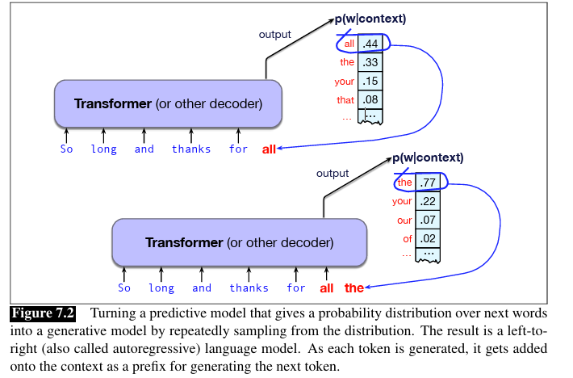
Generative AI
Fundamental intuition of language models
  A model that can predict text (assigning a distribution over following words) can also be used to generate text by sampling from the distribution. (sampling means to choose a word from a distribution)
  Called as autoregressive language model
The idea of using computational models to generate text, code, speech, images, video, audio, constitutes the important new area called Generative AI

Slide 12
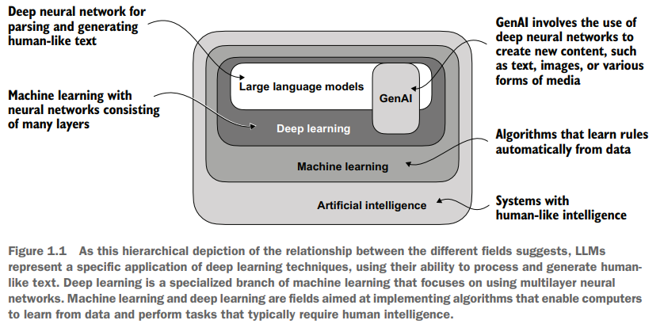
LLMs and Gen AI

Slide 13
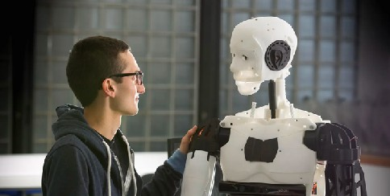
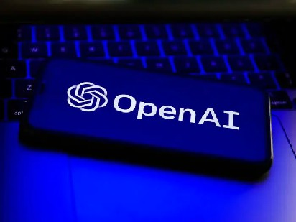

Natural language generation with LLMs
Large Language Models are (mostly) natural language generation (NLG) systems!
The process of generating natural language text with LLMs is called decoding.
LLMs could perform NLG tasks, and many other tasks (e.g., question answering, sentiment analysis, code generation, information extraction…) can be formatted as NLG tasks too!
© University of Lincoln
© Marvel Studios
Credits : https://taoyds.github.io/courses/comp3361

Slide 14
Attention and Transformers Review

Slide 15
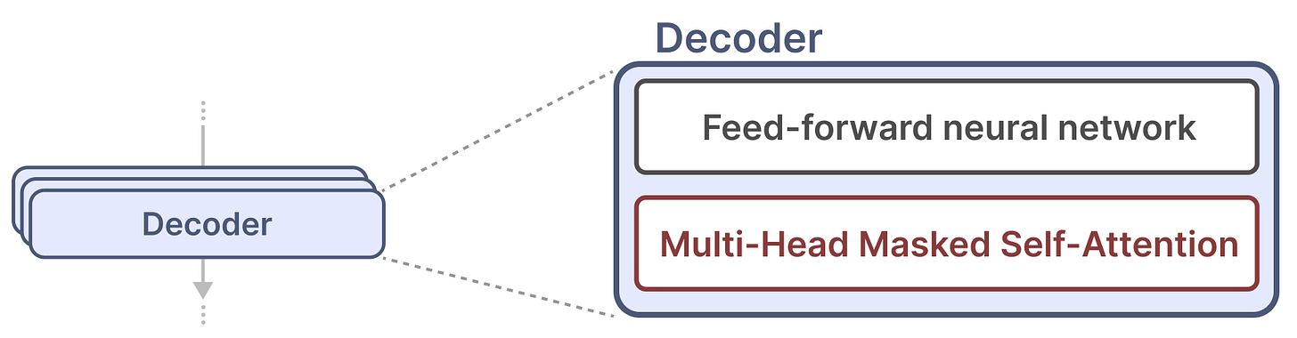
Transformer Decoder
https://newsletter.maartengrootendorst.com/p/a-visual-guide-to-mamba-and-state

Slide 16
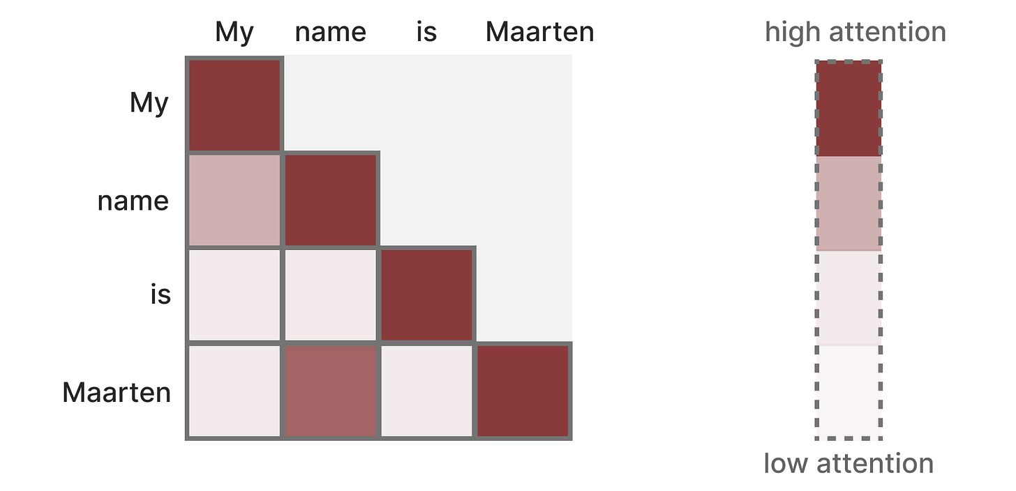
Self attention
It creates a matrix comparing each token with every token that came before
The weights in the matrix are determined by how relevant the token pairs are to one another
During training, this matrix is created in one go
It enables parallelization, which speeds up training tremendously
Self-attention is a major reason why LLMs work so well. It enables an uncompressed view of the entire sequence with fast training
https://newsletter.maartengrootendorst.com/p/a-visual-guide-to-mamba-and-state
Notes:
The attention between “My” and “name” does not need to be calculated first before we calculate the attention between “name” and “is”.

Slide 17
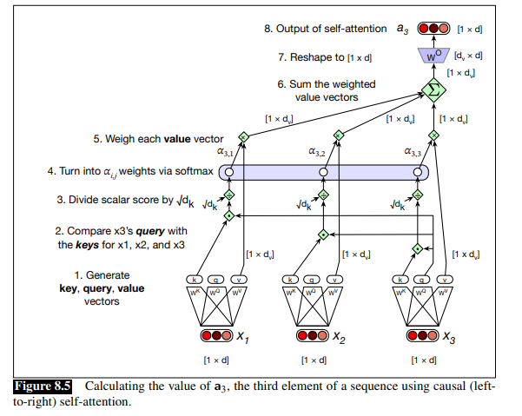
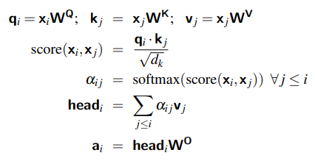
Self attention
Query : As the current element being compared to the preceding inputs
Key : In its role as a preceding input that is being compared to the current element to determine a similarity weight
Value: As a value of a preceding element that gets weighted and summed up to compute the output for the current element
d : model dimensionality
Notes:
Furthermore, the result of a dot product can be an arbitrarily large (positive or negative) value, and exponentiating large values can lead to numerical issues and loss of gradients during training. To avoid this, we scale the dot product by a factor related to the size of the embeddings, via dividing by the square root of the dimensionality of the query and key vectors (dk).

Slide 18
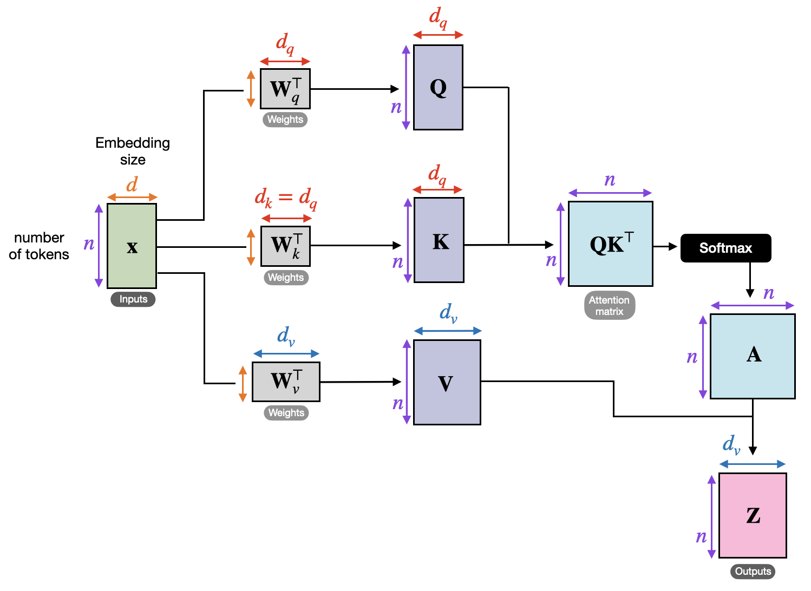
Self attention: Dimensions
original transformer (Vaswani et al., 2017)
d- dimension of the model or embedding dimensions : 512
dk and dv: 64
Image credits: https://sebastianraschka.com/blog/2023/self-attention-from-scratch.html

Slide 19
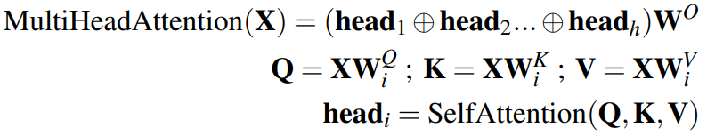
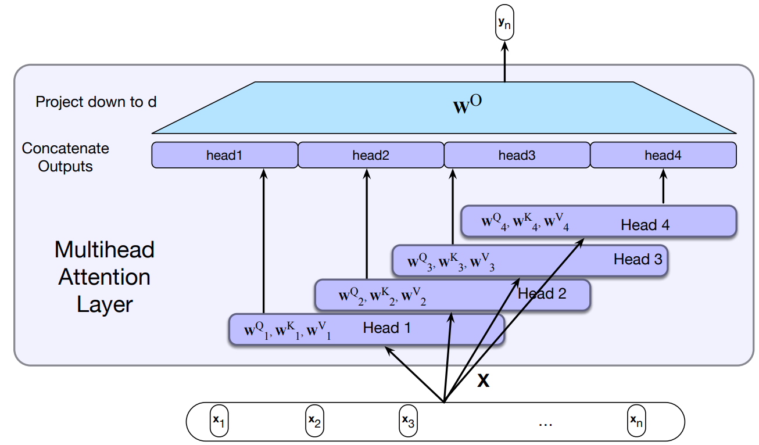
Multihead-Attention
h = 8 parallel attention layers, or heads
For each of these
  d_{k} = d_{v} = d_{model} / h = 64
Due to the reduced dimension of each head, the total computational cost is similar to that of single-head attention with full dimensionality
W^{Qi} ∈R ^{d × dk}
W^{Ki} ∈ R ^{d×dk}
W^{O} ∈R ^{hdv×d}
W^{Vi} ∈ R ^{d× dv}
Each of the multihead self-attention layers is provided with its own set of key, query and value weight matrices.
The outputs from each of the layers are concatenated and then projected down to d, thus producing an output of the same size as the input so layers can be stacked.

Slide 20
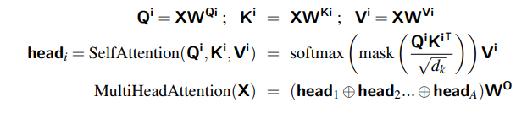
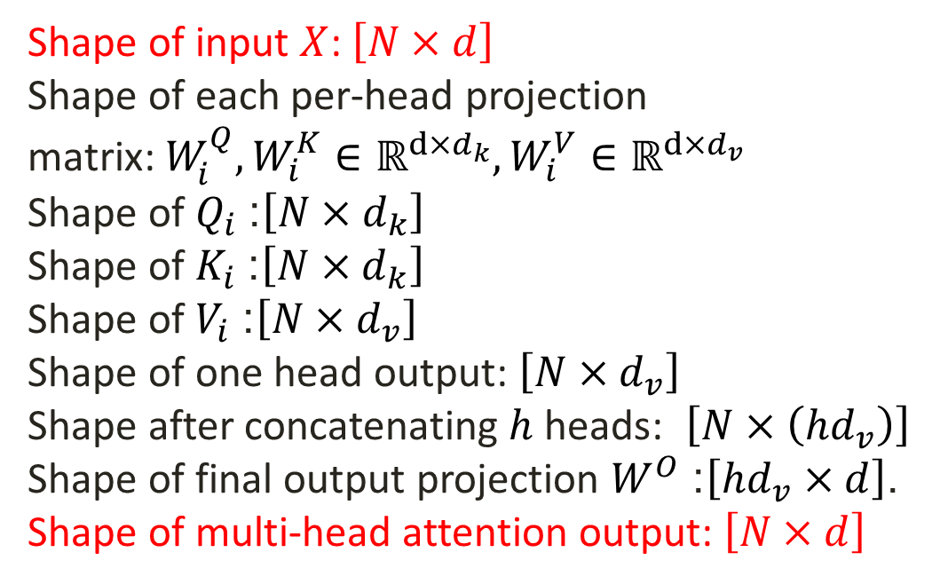
Multi head attention
Input sequence length N=4, d = 512
Number of Attention Heads (A) =8
Dimension of dk​ and dv​: d_{k}​=d_{v}​=d/A=512/8=64 (Each head will work with smaller, 64-dimensional vectors instead of full 512)
Shape of input $X$: $\left[N×d\right]$
Shape of each per-head projection matrix: $W_{i}^{Q},W_{i}^{K}∈ℝ^{d×d_{k}},W_{i}^{V}∈ℝ^{d×d_{v}}$
Shape of $Q_{i}$: $\left[N×d_{k}\right]$
Shape of $K_{i}$: $\left[N×d_{k}\right]$
Shape of $V_{i}$: $\left[N×d_{v}\right]$
Shape of one head output: $\left[N×d_{v}\right]$
Shape after concatenating $h$ heads: $\left[N×\left(hd_{v}\right)\right]$
Shape of final output projection $W^{O}$: $\left[hd_{v}×d\right]$.
Shape of multi-head attention output: $\left[N×d\right]$
Shape of input X : [4×512]
Shape of projection matrices W: →[512×64]
Shape of Q :[4 × 64 ]
Shape of K : [4 × 64 ]
Shape of V : [4 × 64]
Shape of one head output:[4 x 64]
Shape of concatenated outputs of 8 heads : [4×(8×64)] = [4×512]
W^{O} of shape: [(8 x 64) x 512] = [512 x 512]
Shape of final multihead-attention output A : [4×512]

Slide 21
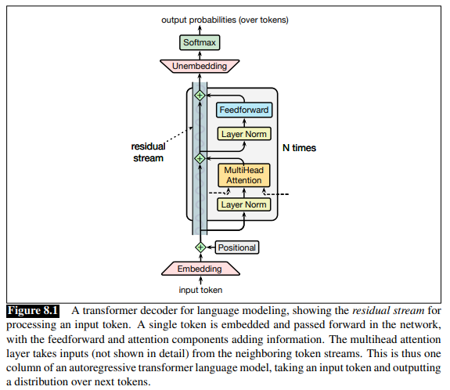
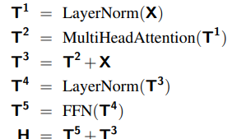

Transformer block
We use transformers to create generative models
by using only decoders
X : input to the layer
T (of shape [N ×d]) transformer computation and superscripts to demarcate each computation inside the block

Slide 22
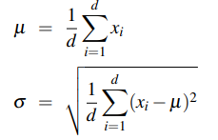



Layer Normalization and FFNN
LayerNorm is applied independently to each token’s hidden vector, normalizing across the feature dimension
Standard implementation of layer normalization has two learnable parameters, γ and β
FFNN uses contextual information created by attention layer to capture complex relationship in data
FFNN is a fully-connected 2-layer network, i.e., one hidden layer, One output layer (two weight matrices)
Hidden layer dimensionality d_{ff} is larger than the model dimensionality d (original transformer model, d = 512 and d_{ff} = 2048)
Notes:
Layer norm is a variation of the z-score from statistics
The attention layer creates contextualized token representations by mixing information across tokens; the FFN then transforms each token representation independently using a nonlinear mapping

Slide 23
Building blocks of LLM

Slide 24
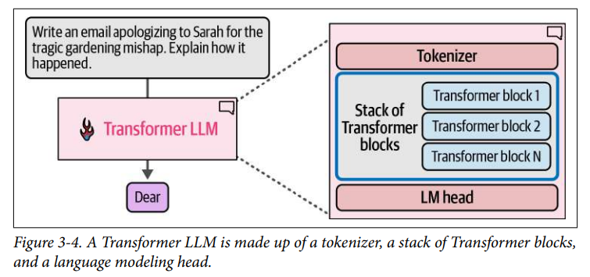
Transformer LLM

Slide 25
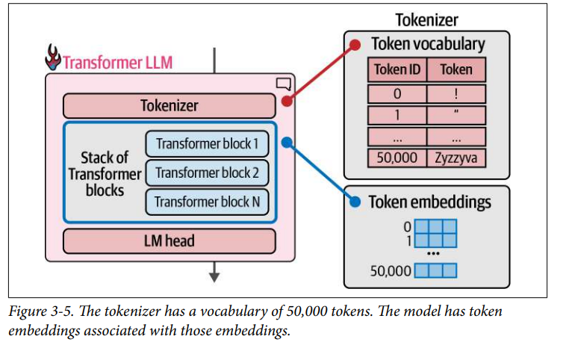
Transformer LLM

Slide 26
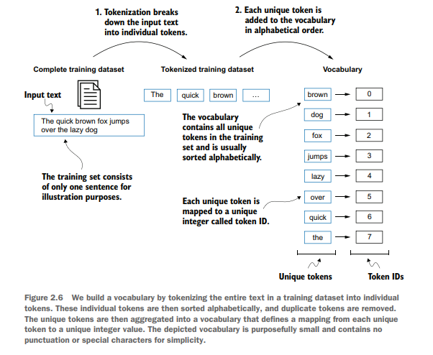
Vocabulary Building

Slide 27
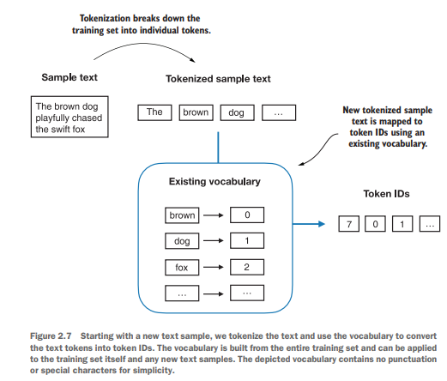
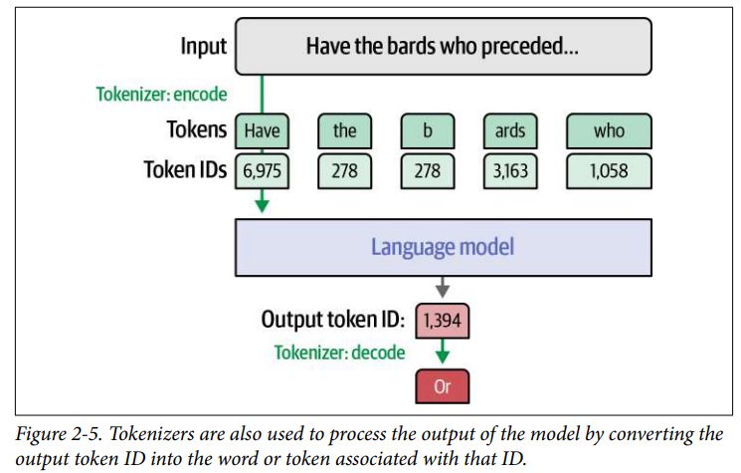
Tokens to token IDs

Slide 28
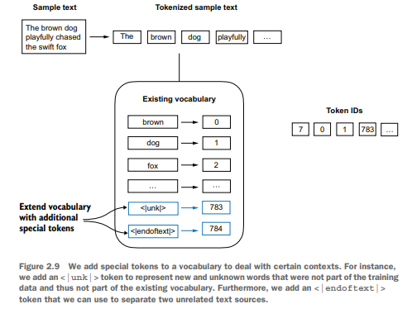
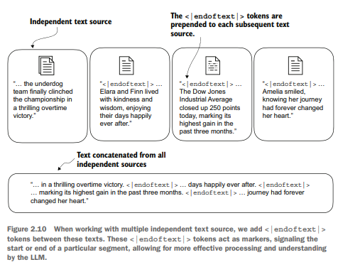
Adding special context tokens

Slide 29
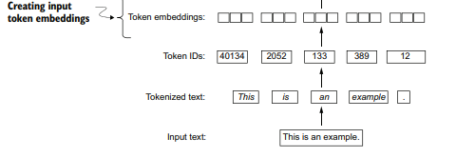
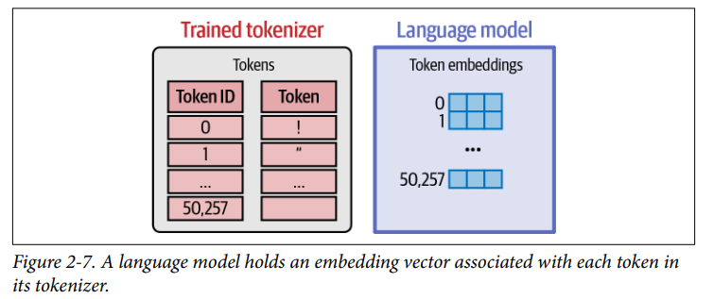
Token IDs to Token Embeddings

Slide 30
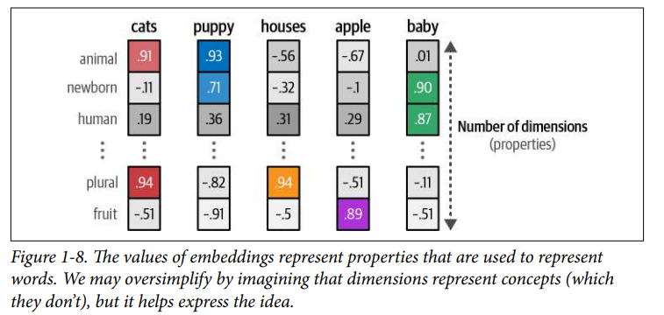
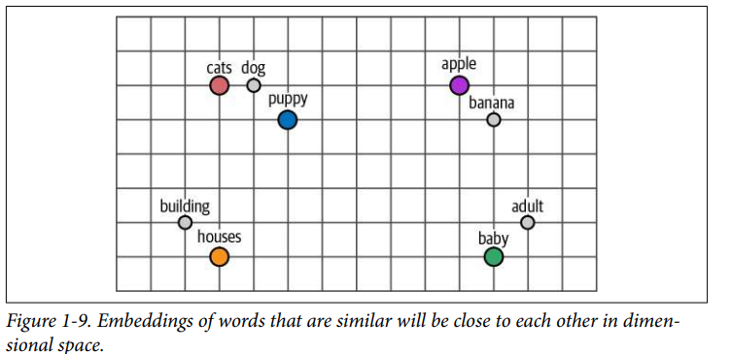
Embeddings

Slide 31
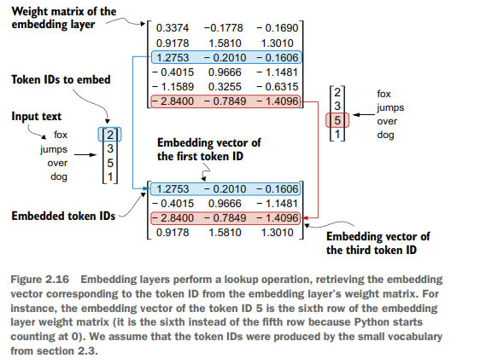
Embedding layer
weight matrix of the embedding layer contains small, random values. These values are optimized during LLM training as part of the LLM optimization itself
weight matrix has rows equal to size of vocab and columns equal to embedding dimension.
Notes:
Input: The list of IDs from the tokenizer.
Action: Uses each ID as an index to look up a row in a massive mathematical table (the Embedding Matrix).
Output: A dense vector of floating-point numbers (e.g., a list of 4,096 numbers for a single token)

Slide 32
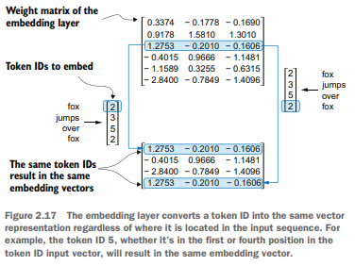
Embedding layer

Slide 33
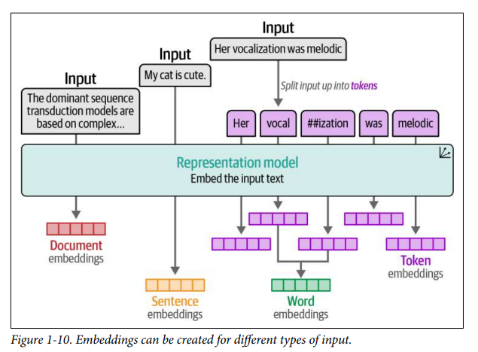
Types of text embeddings
Notes:
Specialized Architectures (SBERT & Doc2Vec)
[CLS] Token Method (Classification) – Sentence
Mean Pooling, Max Pooling:

Slide 34
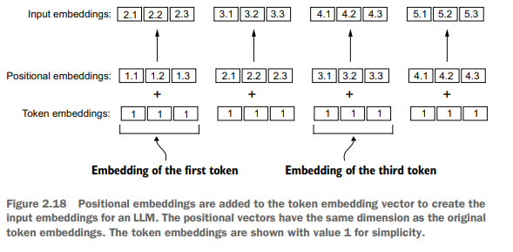
Positional embeddings

Slide 35
Positional Encoding
Because attention has no inherent sense of order, positional encoding is added to embeddings so the model can infer sequence structure.
Learned positional embeddings treat position as a trainable lookup, letting the network discover optimal encodings for dataset
Sinusoidal encodings use fixed sine/cosine functions at multiple frequencies to preserve relative distance
Rotary Positional Embeddings (RoPE) encode position by rotating 𝑄𝐾 in ℂ space; embed relative phase relationships and scale better for long/sliding-window contexts.

Slide 36
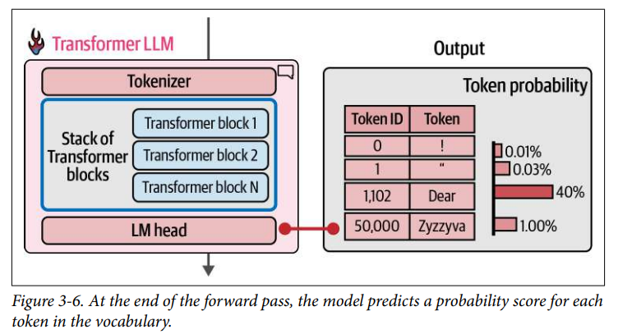
Language Modelling Head
LM maps the final hidden state at each position to vocabulary logits; during training, each position predicts the next token, while during inference the last position is used to generate the next token.
Notes:
Training
For an input sequence of length $N$, the model produces one logits vector at each position, and each position is trained to predict the token that comes immediately after it.
This means the targets are just the input sequence shifted by one position, so the model gets learning signal from many positions in parallel within a single forward pass.
Generation
At inference time, the model still computes logits for all positions in the current prefix, but only the logits from the last position are used to pick the next token.
During training, self-attention is computed for all positions in the sequence in parallel, whereas during inference the initial prompt is also processed across all its tokens, and only the ongoing decoding step focuses on the current last position to produce the next token.

Slide 37
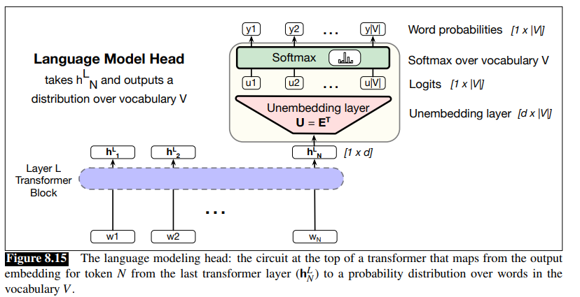

Language Modeling Head
h^{L}_{N} = output token embedding at position N from the final block L (shape of [1×d)
u = logit vector
A softmax layer turns the logits u into the probabilities y over the vocabulary
Softmax probabilities (y) can be used
  To help assign a probability to a given text
  To generate text, (By sampling a word from these probabilities y)

Slide 38
Unembedding or Linear layer
Unembedding matrix (E^{T}) is tied to Embedding matrix (E)
  Weight tying : same weights for two different matrices in the model.
In the learning process, E will be optimized to be good at doing both of these mappings
Input Embedding stage:
  Shape of E : |V|×d
  Shape of One-hot vector over the vocabulary: 1× |V|
  Embedding : One-hot vector x E (Generating d dimensional embedding for a token so shape of [1×d])
Output language model head:
  Shape of E^{T} : d × |V|
  Shape of h^{L}_{N} (Nth Token Embedding : [1×d]
  Logits u : h^{L}_{N} x E^{T} (shape 1×|V|)

Slide 39
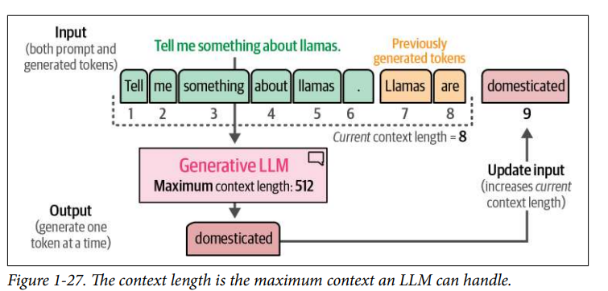
Context length
Context length represents the maximum number of tokens the model can process
Due to the autoregressive nature of these models, the current context length will increase as new tokens are generated
Notes:
A large context window allows entire documents to be passed to the LLM

Slide 40
  LLM Architectures

Slide 41
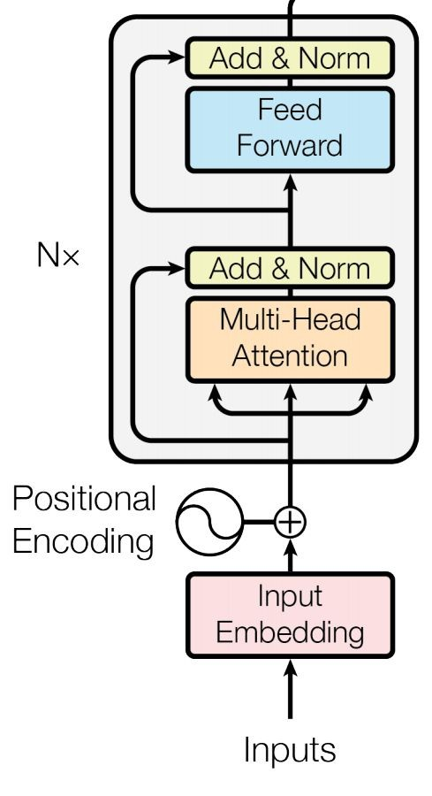
Encoder-Only Models (e.g., BERT, RoBERTa)
Encoder-based LLMs learn contextual understanding rather than free-form generation.
Architecture: Transformer encoder stacks with bidirectional self-attention
Training Objective: MLM, where you randomly mask tokens and predict them using both left and right context.
Context: Bidirectional
Strengths: Excels at comprehension tasks such as classification, NER, and sentiment analysis because it builds dense semantic representations.
Weaknesses: Not naturally generative; requires adapter heads or fine-tuning for sequence output
Example: BERT remains a reference model for tasks that require deep bidirectional context.

Slide 42
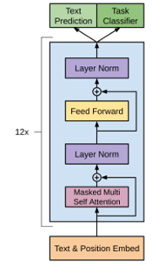
Decoder-Only Models (e.g., GPT, LLaMA)
GPT 1
Decoder-based LLMs are trained to predict the next token given all previous ones, capturing temporal dependency through autoregression (progressively generating sequence of outputs).
Architecture: Transformer decoder stacks with causal masking that blocks access to future tokens
Training Objective: CLM, where you minimize cross-entropy over next-token predictions
Context: Unidirectional (left-to-right) to maintain causal structure
Strengths: Outstanding at open-ended text generation, dialogue, code completion, and story synthesis
Weaknesses: Less efficient for classification or bidirectional reasoning
Example: GPT models, Meta’s LLaMA series etc.

Slide 43
Encoder-Decoder Models (e.g., T5, BART)
These models bridge the understanding and generation paradigms by pairing an encoder (MLM-like) with a decoder (CLM-like)
Architecture: An encoder transforms the input sequence into contextual representations; a decoder generates outputs via cross-attention
Training Objective: Sequence-to-sequence learning-often formulated as translation or summarization-and sometimes a span-corruption variant of MLM as in T5
Strengths: Effective for translation, summarization, and multimodal pipelines where the input and output domains differ
Weaknesses: Dual stacks increase training complexity and inference latency.
Example: T5 and BART use span-corruption pre-training and autoregressive decoding; multimodal systems (speech-text, vision-language) extend the same blueprint

Slide 44
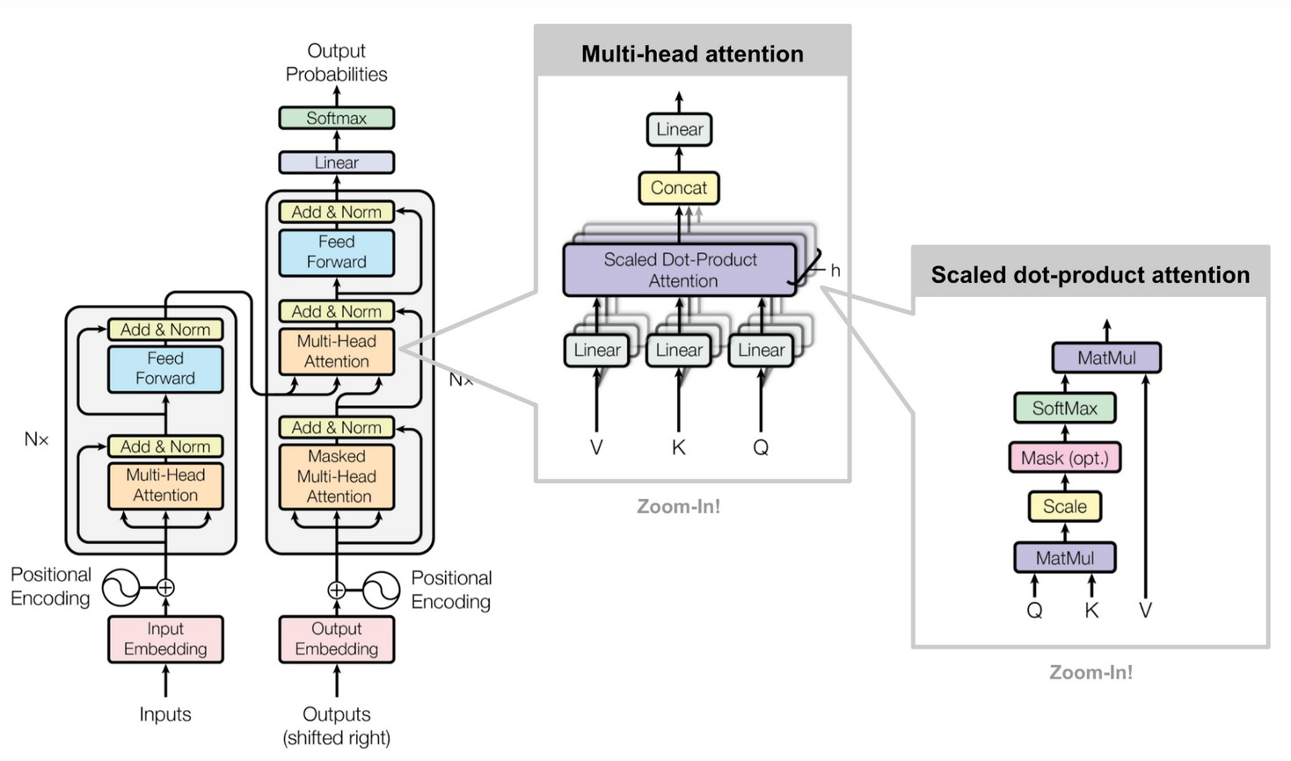
Transformer Encoder-Decoder

Slide 45
Tokenization

Slide 46
Word structure and subword models
Common words end up being a part of the subword vocabulary, while rarer words are split into (sometimes intuitive, sometimes not) components.
In the worst case, words are split into as many subwords as they have characters.
word
vocab mapping hat
learn
taa## aaa## sty la## ern## Transformer## ify
embedding
hat learn
taaaaasty laern
→
→
→
→
Common
words
Variations
misspellings
novel items
Transformerify →
Notes:
Instead of
white-space segmentation
single-character segmentation
Use the data to tell us how to tokenize.
Subword tokenization (because tokens can be parts of words as well as whole words)

Slide 47
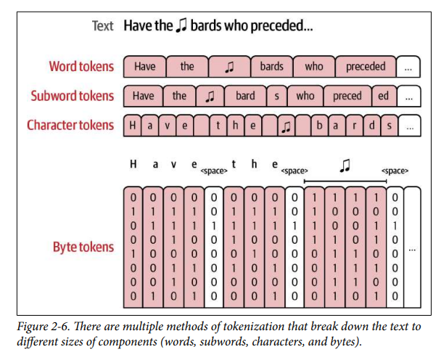
Types of tokens
Word Tokens (E.g.word2vec)
Unable to deal with new words that enter the dataset after the tokenizer was trained
A lot of tokens with minimal differences between them (e.g., apology, apologize, apologetic, apologist)
Subword Tokens
Ability to represent new words by breaking down the new token into smaller characters, which tend to be a part of the vocabulary
Byte tokens
vocabulary based on UTF-8 bytes (256)
One Token = One Byte
E.G : "Apple"
[65] [112] [112] [108] [101] (5 tokens)
Tokenizer-free" model (e.g. ByT5 or CANINE)
Notes:
Subword tokens present an advantage over character tokens in the ability to fit more text within the limited context length of a Transformer model. So with a model with a context length of 1,024, you may be able to fit about three times as much text using subword tokenization than using character tokens (subword tokens often average three characters per token).

Slide 48
Subword tokenization
Three common algorithms:
  Byte-Pair Encoding (BPE) (Sennrich et al., 2016)
  Unigram language modeling tokenization (Kudo, 2018)
  WordPiece (Schuster and Nakajima, 2012)
All have 2 parts:
  A token learner that takes a raw training corpus and induces a vocabulary (a set of tokens).
  A token segmenter that takes a raw test sentence and tokenizes it according to that vocabulary
Vocabulary is built dynamically
  Frequent words get assigned their own tokens
  Rare words are split into sub-words

Slide 49
Byte Pair Encoding
An efficient learning implementation of BPE:
Pretokenization: Split the corpus into words (e.g. using a rule-based tokenizer)
Construct a word dictionary with frequency counts
("hug", 10), ("pug", 5), ("pun", 12), ("bun", 4), ("hugs", 5)
Start from uni-character vocabulary, merge pairs by frequency, till reached target vocabulary size
Iteration | Current Vocab | Tokenization of Words
1 | ["b", "g", "h", "n", "p", "s", "u"] | ("h" "u" "g", 10), ("p" "u" "g", 5), ("p" "u" "n", 12), ("b" "u" "n", 4), ("h" "u" "g" "s", 5)
2 | ["b", "g", "h", "n", "p", "s", "u", "ug”] | ("h" "ug", 10), ("p" "ug", 5), ("p" "u" "n", 12), ("b" "u" "n", 4), ("h" "ug" "s", 5)
3 | ["b", "g", "h", "n", "p", "s", "u", "ug” “un”] | ("h" "ug", 10), ("p" "ug", 5), ("p" "un", 12), ("b" "un", 4), ("h" "ug" "s", 5)
4 | ["b", "g", "h", "n", "p", "s", "u", "ug” “un”, “hug”] | ("hug", 10), ("p" "ug", 5), ("p" "un", 12), ("b" "un", 4), ("hug" "s", 5)

Slide 50
Byte Pair Encoding
Find Most Frequent Pair: The algorithm scans the tokenized words and their frequencies to find the most common adjacent pair.
  ("u", "g") appears in "hug" (10), "pug" (5), and "hugs" (5). Total = 20 times
  ("u", "n") appears in "pun" (12) and "bun" (4). Total = 16 times
  ("h", "u") appears in "hug" (10) and "hugs" (5). Total = 15 times
Result: The pair ("u", "g") is the most frequent (20 occurrences)
A new token "ug" is created by merging "u" and "g“
New token "ug" is added to the vocabulary: [..."u", "ug"]

Slide 51
Byte Pair Encoding
Advantages:
Efficient handling of rare words and subword units.
Reduces the vocabulary size, making the model more efficient.
Helps in better generalization by breaking down words into subword units.
Limitations:
Can produce fragmented tokens for some languages, especially those with complex morphology.
May not capture semantic meaning as effectively as other tokenization methods.

Slide 52
SentencePiece
SentencePiece is a language-independent subword tokenizer that learns directly from raw text using a fixed vocabulary size.
It supports multiple segmentation algorithms, including BPE and unigram language modeling.
SentencePiece preserves whitespace explicitly by replacing spaces with the meta symbol ▁ before segmentation.
T5, Llama, Gemma uses a SentencePiece-based tokenizer
Input text: Tokenization matters
Whitespace-marked form: ▁Tokenization▁matters
Possible token pieces: [▁Token, ization, ▁matters] or another valid split depending on the learned vocabulary
Input text: Hello world
Whitespace-marked form: ▁Hello▁world
Possible token pieces: [▁Hello, ▁world] or a finer split depending on the learned vocabulary
In unigram tokenization, the tokenizer chooses the most probable segmentation from multiple candidate segmentations
E.g. “lowering” may be segmented as [lower, ing] instead of [low, er, ing] if the first split has higher learned probability
Notes:
Many models, including T5, LLaMA, and Gemma, use SentencePiece-based tokenizers; the underlying segmentation may be unigram or BPE depending on the model

Slide 53
Language models landscape
Pre-neural (before 2010s)
Language model to measure the entropy of English [Shannon 1950]
Lots of work on n-gram language models (for machine translation, speech recognition)
Neural ingredients (2010s)
First neural language model [Bengio+ 2003]
Sequence-to-sequence modeling (for machine translation) [Sutskever+ 2014]
Adam optimizer [Kingma+ 2014]
Attention mechanism (for machine translation) [Bahdanau+ 2014]
Transformer architecture (for machine translation) [Vaswani+ 2017]
Mixture of experts [Shazeer+ 2017]
Model parallelism [Huang+ 2018], [Rajbhandari+ 2019], [Shoeybi+ 2019]

Slide 54
Language models landscape
Early foundation models (late 2010s)
ELMo: pretraining with LSTMs, fine-tuning helps tasks
BERT: pretraining with Transformer, fine-tuning helps tasks
Google's T5 (11B): cast everything as text-to-text
Embracing scaling, more closed
OpenAI's GPT-2 (1.5B): fluent text, first signs of zero-shot, staged release
Scaling laws: provide hope / predictability for scaling, Kaplan law
OpenAI's GPT-3 (175B): in-context learning, closed
Google's PaLM (540B): massive scale, undertrained
DeepMind's Chinchilla (70B): compute-optimal scaling laws
Open models
EleutherAI's open datasets (The Pile) and models (GPT-J)
Meta's OPT (175B): GPT-3 replication, lots of hardware issues
Hugging Face / BigScience's BLOOM: focused on data sourcing
Meta's Llama models
Alibaba's Qwen models
DeepSeek's models
AI2's OLMo 2

Slide 55
Language models landscape
Levels of openness
Closed models (e.g., GPT-4o): API access only
Open-weight models (e.g., DeepSeek): weights available, paper with architecture details, some training details, no data details
Open-source models (e.g., OLMo): weights and data available, paper with most details (but not necessarily the rationale, failed experiments)
Today's frontier models
OpenAI's o3
Anthropic's Claude Sonnet 3.7
xAI's Grok 3
Google's Gemini 2.5
Meta's Llama 3.3
DeepSeek's r1
Alibaba's Qwen 2.5 Max
Tencent's Hunyuan-T1
The list grows………………….

Slide 56
Recent models
Model Family | Key Release | Primary Strength
OpenAI | GPT-5.4 Thinking | Deep reasoning, tool use, and long-horizon research tasks
Google | Gemini 3.1 Pro | Complex problem-solving, multimodal understanding, and tool-based workflows
Google | Gemma 4 | Open-weight reasoning, multimodal understanding, and agentic workflows
Anthropic | Claude Opus 4.6 | Long-context reasoning, coding, and sustained agentic work
Mistral | Mistral Large 3 | Open-weight multimodal performance with efficient sparse MoE design
xAI | Grok 4.20 | Parallel multi-agent research and collaborative task execution
DeepSeek | DeepSeek-R1 | Reinforcement-learning-driven math, logic, and reasoning performance

Slide 57
References
Speech and Language Processing (3rd ed. draft) Dan Jurafsky Jan 2026 - Ch- 2, 7, 8
Hands-On Large Language Models – Jay Alamar : Ch-1,2,3
Build a Large Language Model (From Scratch) SEBASTIAN RASCHKA : Ch-1,2
https://huggingface.co/learn/llm-course/en/chapter6/5
Research Papers
Neural Machine Translation with Byte-Level Subwords

Slide 58
Extra slides (Not for exams)

Slide 59
Byte tokens Vs BPE
e.g. "Café 🚀"
[67] (C)
[97] (a)
[102] (f)
[195] (First half of é)
[169] (Second half of é)
[32] (Space)
[240] (Byte 1 of 🚀)
[159] (Byte 2 of 🚀)
[154] (Byte 3 of 🚀)
[128] (Byte 4 of 🚀)
Total Tokens: 10
Byte Tokens
  Text → UTF-8 Bytes → Tokens
  It never merges anything. Every byte is its own token
  Extremely inefficient (long sequences), but can read absolutely any file or character
BPE
  Text →Characters → Merge Frequent Pairs →Tokens
  It is efficient for what it knows but "blind" to what it doesn't
e.g. "Café 🚀"
[Café] (Likely merged into one common token)
[ ] (Space)
[UNK] (The Failure!)
Total Tokens: 3 (but one is broken)

Slide 60
Byte-level BPE ( GPT2)
UTF8 encoding of text, which encodes each Unicode character into 1 to 4 bytes.
This allows to model a sentence as a sequence of bytes instead of characters.
It starts with 256 bytes but learns to "glue" them into useful words.
Text →Bytes → Merge Frequent Byte Sequences → Tokens
Zero unknown words because it can always fall back to the individual bytes if it needs to.
GPT-2 uses byte-level BPE with a vocabulary size of 50,257 (256 byte tokens + 50,000 merges + special end-of-text token).
E.g. "Café 🚀":
[Café] (Byte sequence 67 97 102 C3 A9 merged into one ID)
[ 🚀] (Space + Emoji bytes merged into one ID)
Total Tokens: 2

Slide 61
Byte level BPE example
Sentence: The sun is ☀️
Words | Raw Bytes | Token ID | Explanation
The | 54 68 65 | 464 | A very common English word; merged into one token.
sun | 20 73 75 6e | 6035 | The space is "glued" to the word; merged into one token.
is | 20 69 73 | 374 | Another common "space + word" merge.
 | 20 | 220 | A single space before the emoji.
☀️ | E2 98 80 ... | 99321 | One Token! Because this is a common emoji, the model has merged all the underlying bytes into a single entry.
Notes:
Byte: 8 bits
Character (UTF-8): 1 to 4 bytes
BPE Token: 1 to N bytes (where N is limited by training data and vocabulary size)
Compression: If a model has a context window of 8,000 tokens, and each token averages 4 bytes, the model can "see" 32,000 characters. If the tokenizer was 1-byte-only, the model would only see 8,000 characters.
Cost: users if charged per token, a tokenizer that packs more bytes into one token is cost effective

Slide 62

Wordpiece
WordPiece Tokenization is a method used to split text into smaller subword units, which helps in handling rare words and improving the efficiency of language models.
How WordPiece Works:
Start with a Base Vocabulary: Begin with a small vocabulary that includes individual characters and special tokens.
Identify Subword Units: Count How Often Letters Appear Together
Compute Scores for Pairs: Instead of merging the most frequent pairs, WordPiece computes a score for each pair
using the formula:
Merge Pairs: Merge pairs based on their scores, prioritizing pairs where the individual parts are less frequent.
Repeat: Continue the process until the desired vocabulary size is reached.
Reference: Google’s Neural Machine Translation System (Wu et al., 2016)

Slide 63
Wordpiece
Advantages:
Efficient Handling of Rare Words: Breaks down rare words into subword units, improving model performance.
Reduces Vocabulary Size: Helps in creating a manageable vocabulary size.
Better Generalization: By using subword units, it can generalize better across different words and contexts.
Limitations:
Complexity: The scoring mechanism adds complexity compared to simpler methods.
Fragmentation: Can still produce fragmented tokens, especially for languages with complex morphology.
WordPiece's use of a likelihood-based scoring method distinguishes it from BPE's simpler frequency-based approach, often resulting in a vocabulary that better captures the linguistic structure of the training data.

Slide 64
WordPiece tokenization algorithm
WordPiece is the tokenization algorithm Google developed to pretrain BERT.
It’s very similar to BPE in terms of the training, but the actual tokenization is done differently.
Starts from a small vocabulary : special tokens used by the model and the initial alphabet.
Identifies subwords by adding a prefix (like ## for BERT),
  "word" gets split like this: w ##o ##r ##d
Initial vocabulary contains all the characters present at the beginning of a word and the characters present inside a word preceded by the WordPiece prefix.

Slide 65
Tokenization example using wordpiece
Corpus uses these five words: "hug", "pug", "pun", "bun", "hugs"
Assume the words had the following frequencies: ("hug", 10), ("pug", 5), ("pun", 12), ("bun", 4), ("hugs", 5)
Training: token learner : splitting words and adding a prefix ## for subwords
    ("h" "##u" "##g", 10), ("p" "##u" "##g", 5), ("p" "##u" "##n", 12),
    ("b" "##u" "##n", 4), ("h" "##u" "##g" "##s", 5)
First iteration: initial vocabulary : ["b", "h", "p", "##g", "##n", "##s", "##u"] (ignoring special tokens)
    Score ("##u", "##g") : pair freq/individual freq = 20/36*20=1/36
    Score ("##g", "##s"): pair freq/individual freq = 5/20*5=1/20
    Likewise compute scores for all the pairs
    first merge learned is ("##g", "##s") -> ("##gs")
Vocabulary after first iteration: ["b", "h", "p", "##g", "##n", "##s", "##u“, "##gs" ]
Repeat iterations till you get a desired vocab size.

Slide 66
Tokenization example using wordpiece
Token segmenter: New inputs are tokenized by applying the following steps:
  Pre-tokenize it
  Split it
  Apply the tokenization algorithm on each word.
    Look for the biggest subword starting at the beginning of the first word and split it
    Repeat the process on the second part
    And so on for the rest of that word and the following words in the text
Continuing the example: suppose the final vocab learnt:
  Vocabulary: ["b", "h", "p", "##g", "##n", "##s", "##u", "##gs", "hu", "hug"]
  Corpus: ("hug", 10), ("p" "##u" "##g", 5), ("p" "##u" "##n", 12), ("b" "##u" "##n", 4), ("hu" "##gs", 5)
  Test word : “hugs”
  Tokenization of "hugs" is ["hug", "##s"]

